Slide 1



Natural Balance - Dog (US)
Ethos Pet Brands
PCR
May 5 - June 11, 2025

Slide 2

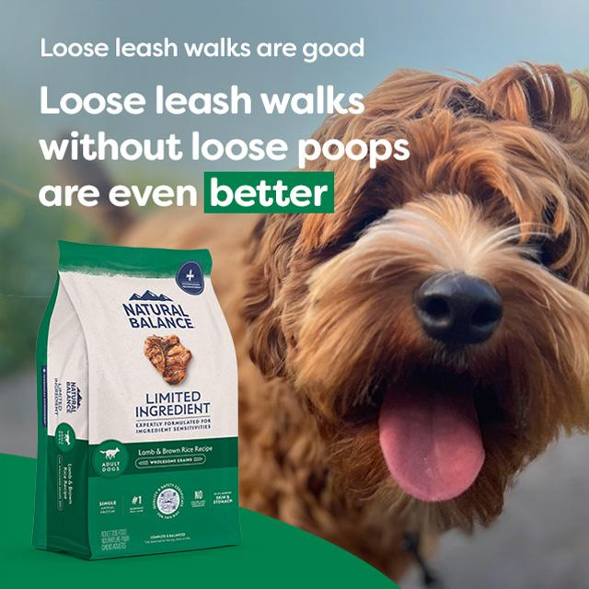
Campaign Overview
Flight: May 5 - June 11
Budget: $102,000 USD
Geo: All of USA
Placements: Billboards, Bus Shelters & Urban Panels
POI: Pet Smart Stores
Audience: N/A
Dayparting: All Days of the week / 8:00 AM to 8:00 PM
Screens: 6903
Publisher: Branded Cities, Lamar Outdoor, Intersection, Clear Channel Outdoor, JCDecaux US, Adams Outdoor, New Tradition, Outfront, Adkom, Volta Media, A Shell Brand, Pacific Outdoor Advertising, WOW Media, Orange Barrel Media, Liquid Group, Corner Media, The Great Outdoor
Impressions Served: 12,443,939
eCPM: $8.19
Spend: $101,941.84 USD

Slide 3
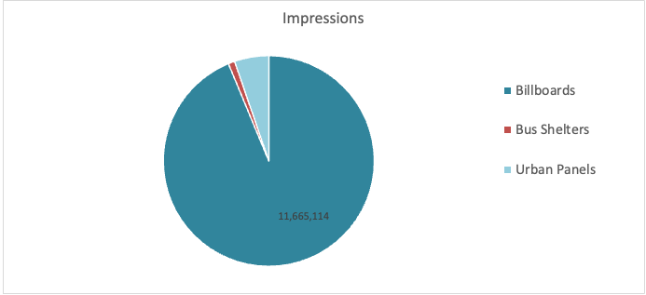
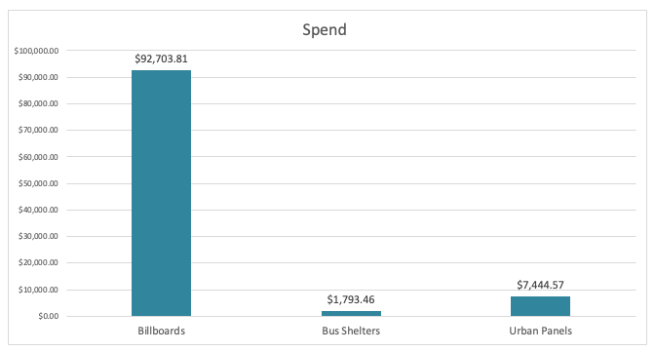
Venue Type Breakdown

Slide 4
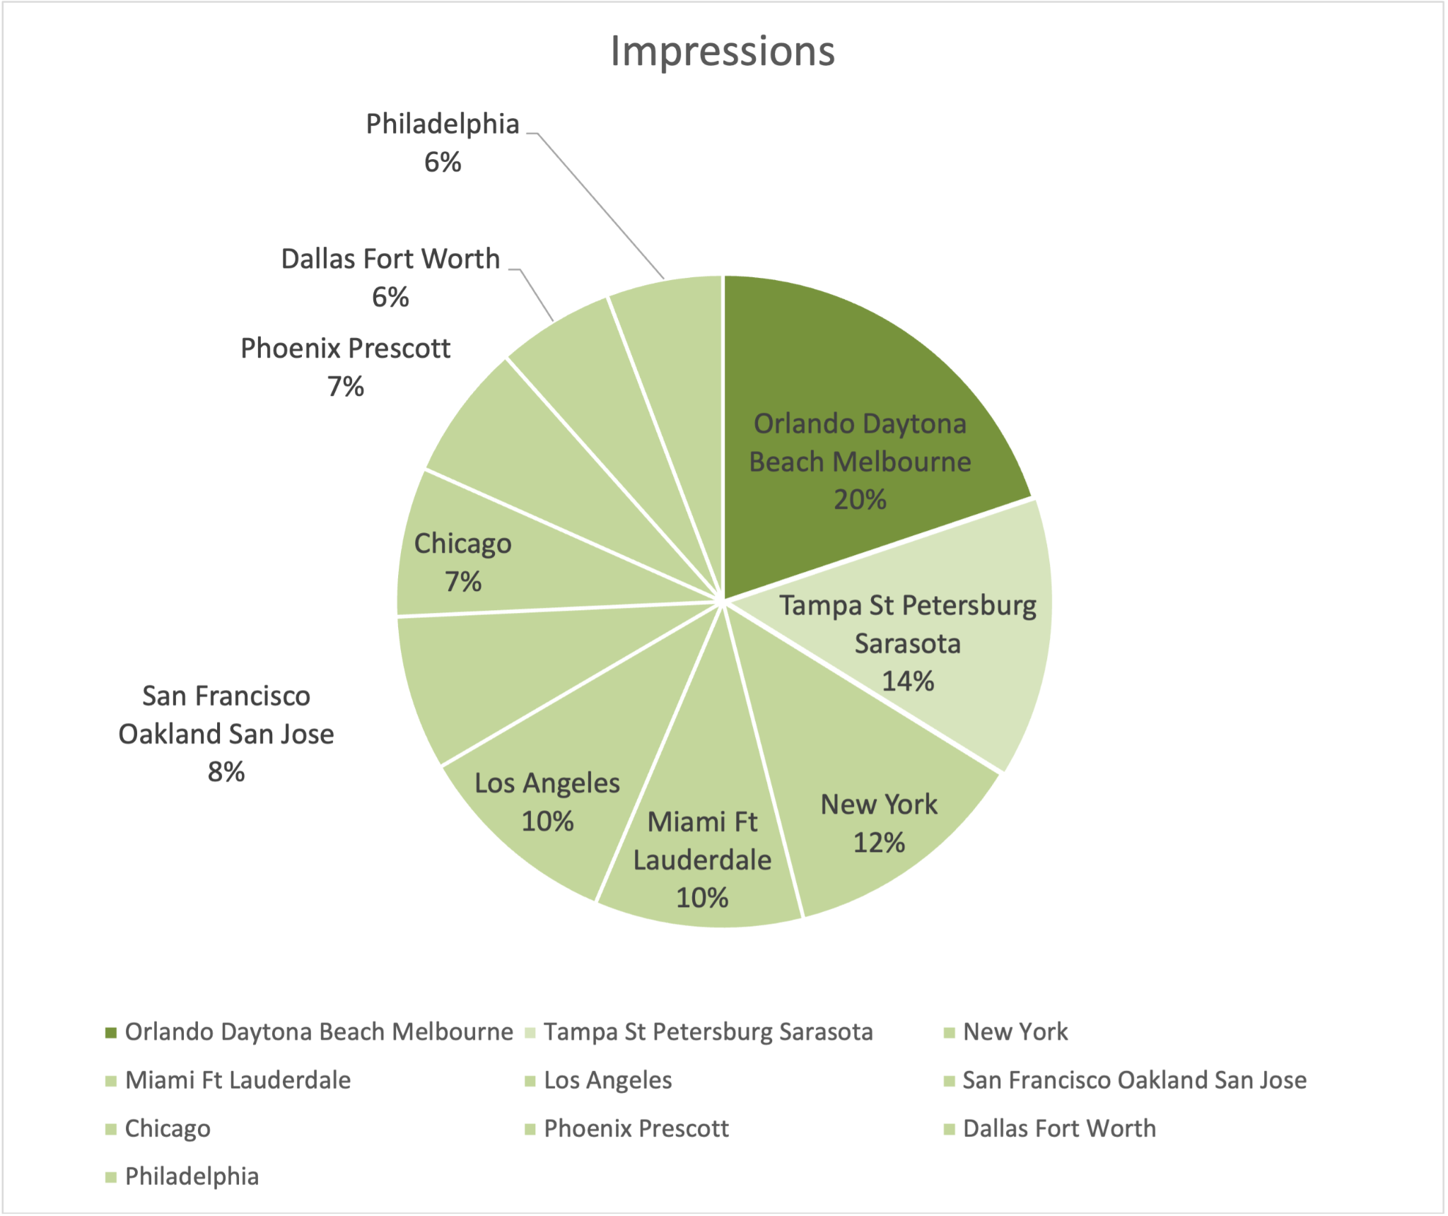
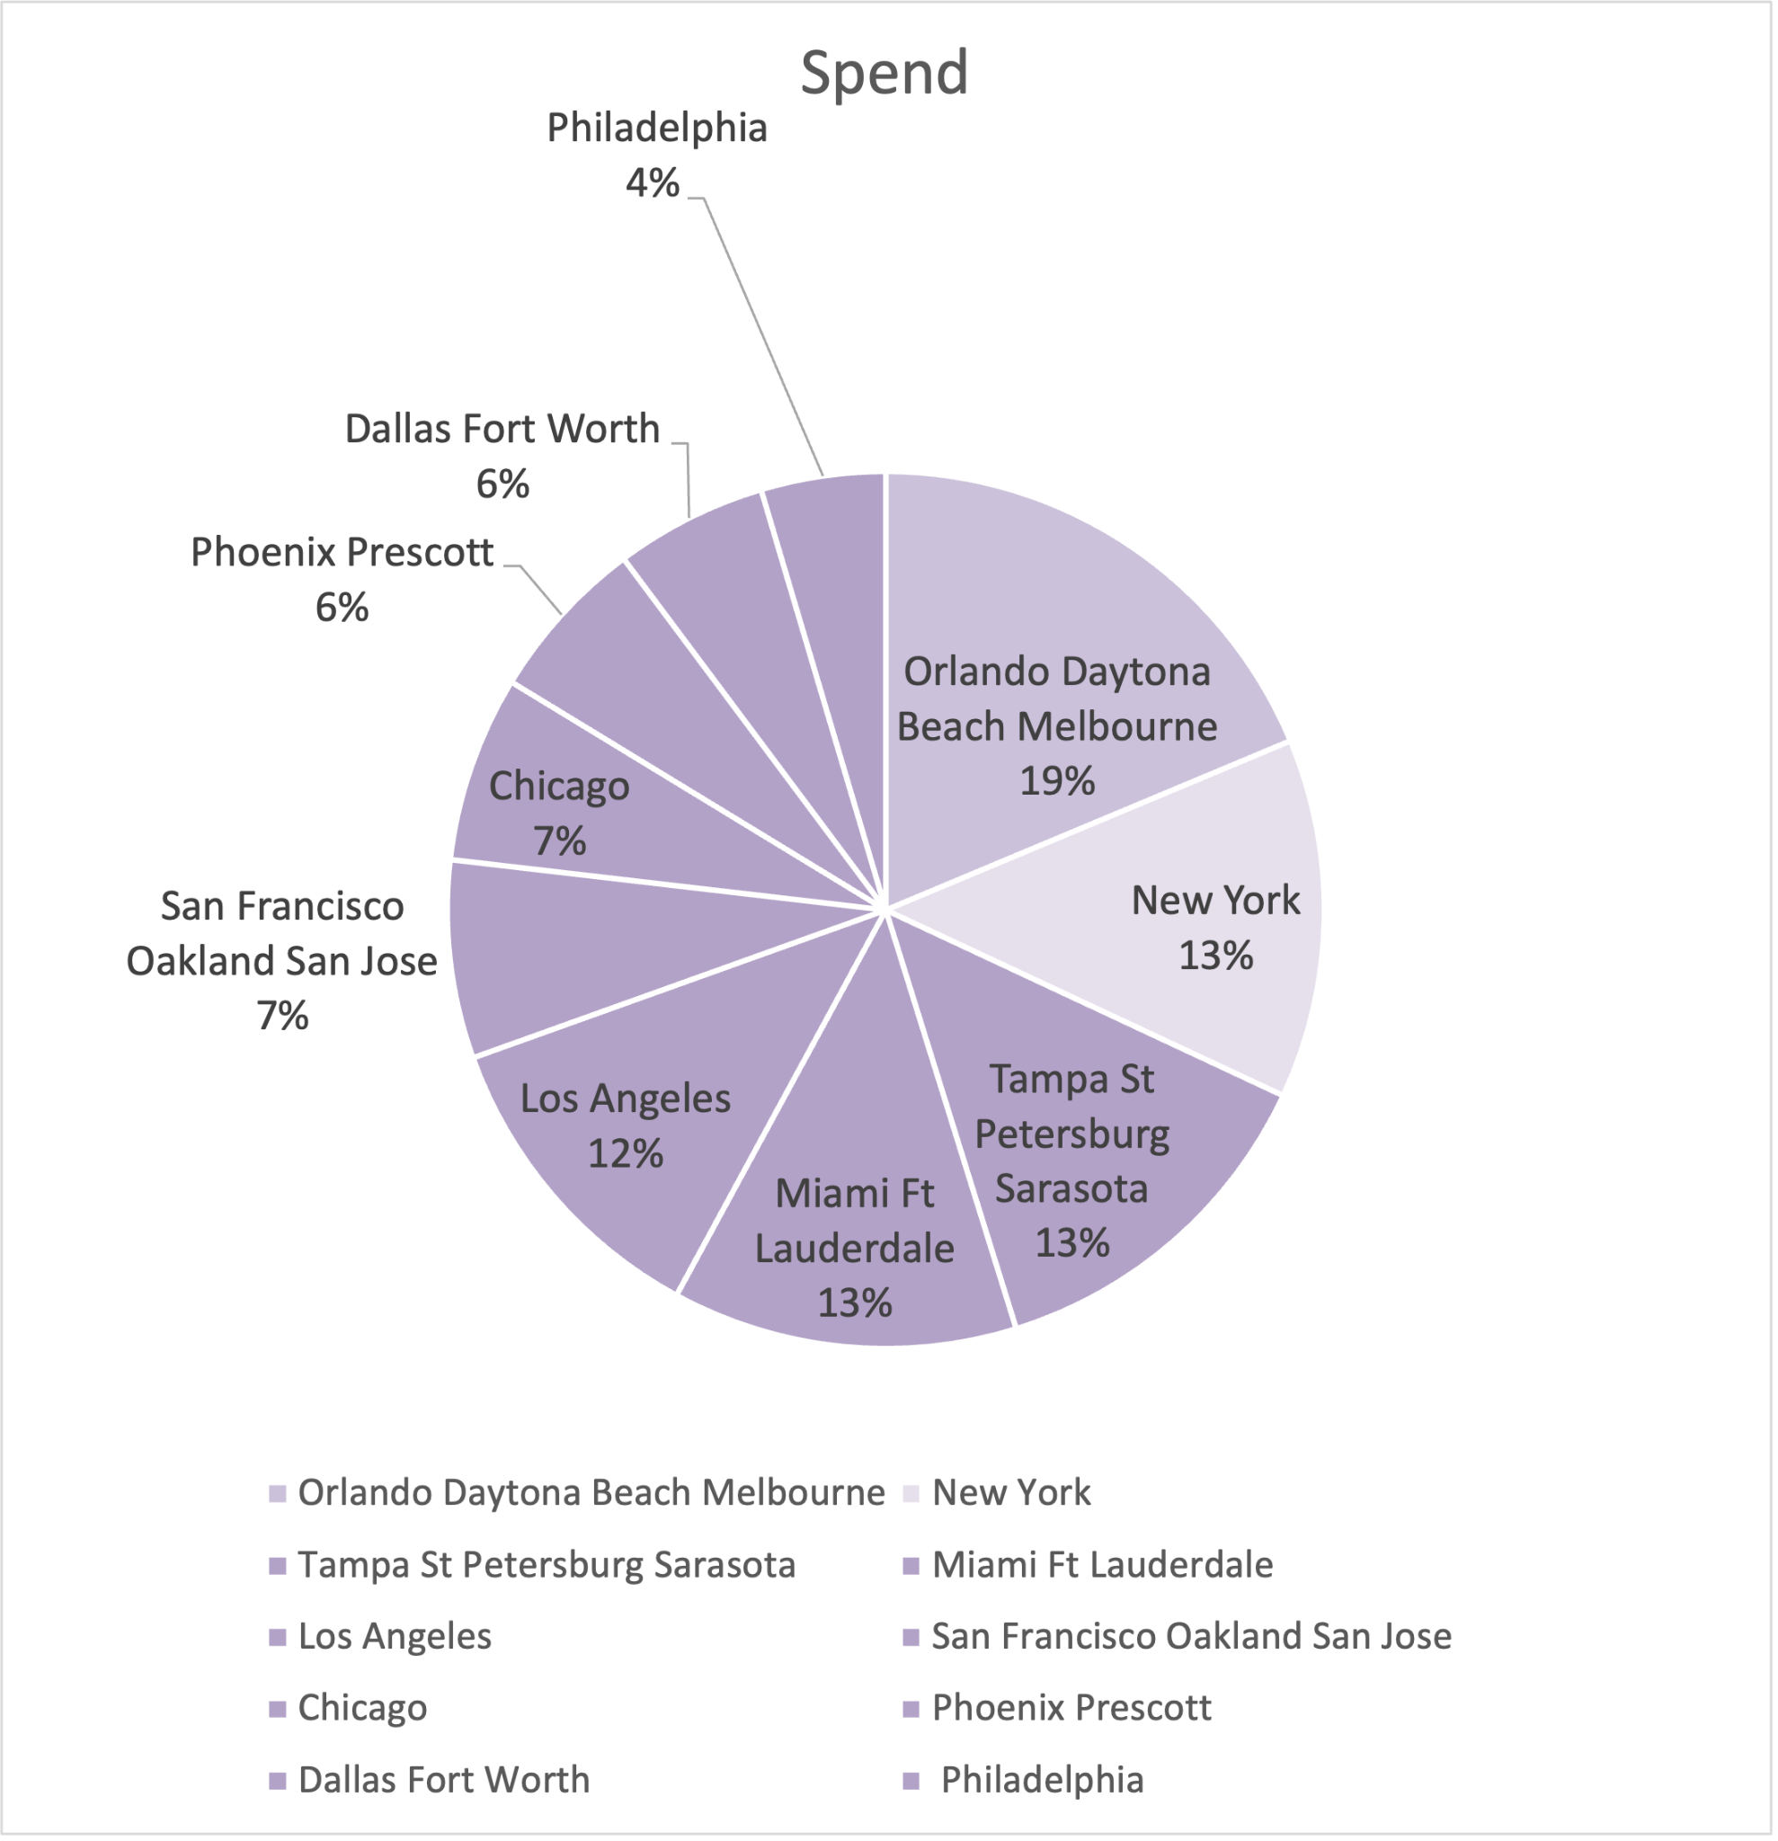
Market (by DMA) Breakdown

Slide 5
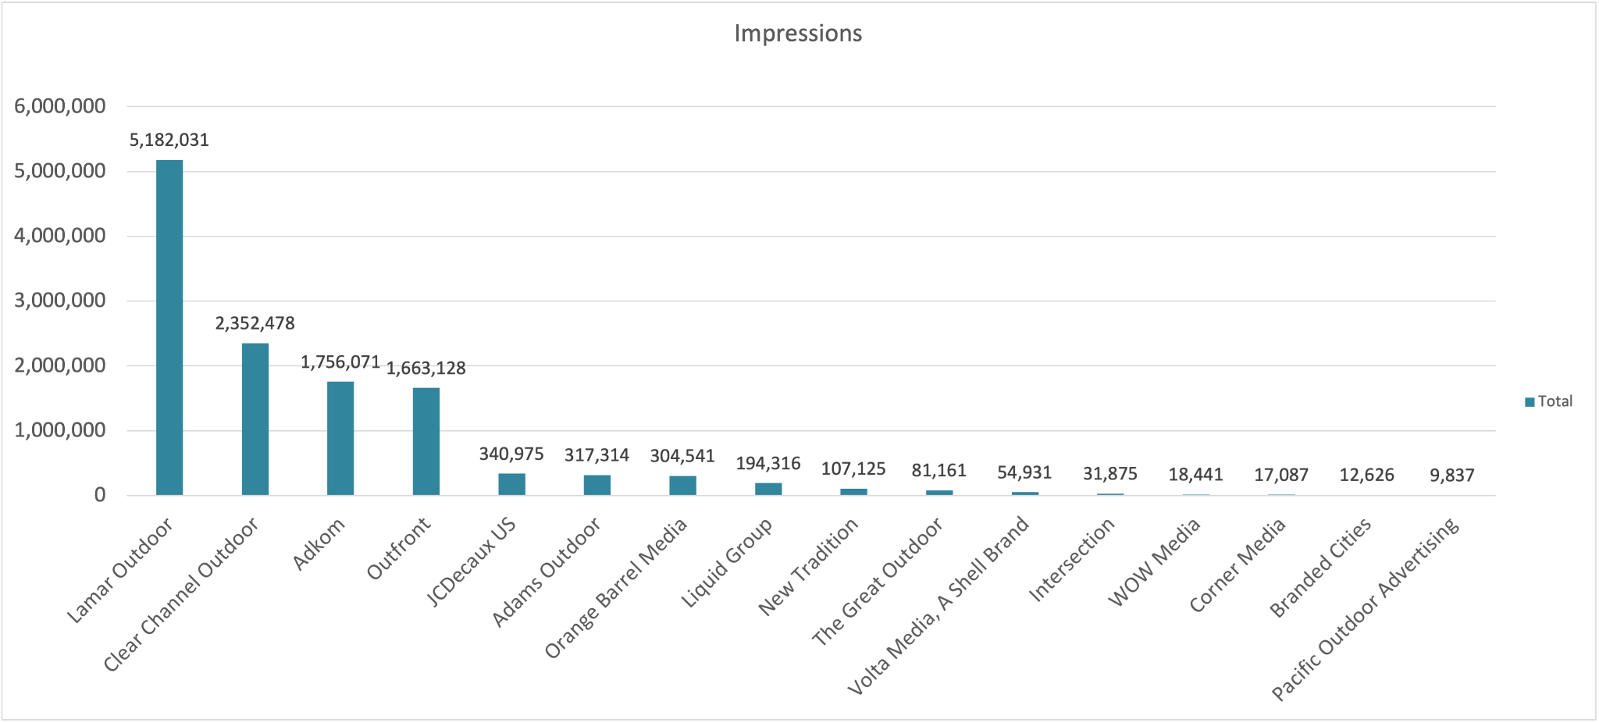
Publisher Breakdown by Impressions

Slide 6
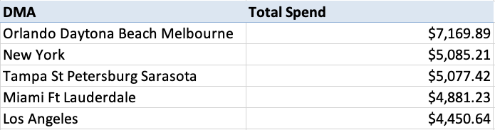
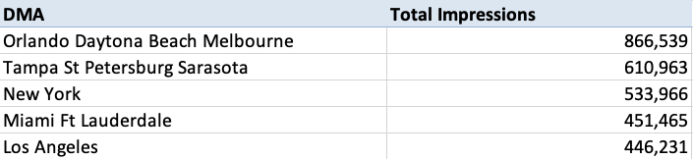
Delivery Insights
The campaign finished at 99.9%, delivering 12,443,939 impressions for an overall eCPM of $8.19.
The top 5 DMA’s in spend were Orlando -Daytona Beach -Melbourne, New York, Tampa -St Petersburg-Sarasota, Miami - Ft Lauderdale, Los Angeles. These DMA’s were also the top 5 in delivered impressions.
The top location with the most impressions delivered was Butte-Bozeman, MT (I-90 N/L @ MP 296.5 F/E #2), followed by 1470 Kleppe Lane (Sparks, NV), and Orlando-Daytona Beach-Melbourne, FL (ORL005884).
Of the 5 publishers on the plan, Lamar Outdoor served the most impression at 41%, with Clear Channel Outdoor at the number 2 spot with 19%. Adkom and Outfront both finished at 14% and 13% of the impression delivered, and JCDecaux US, Adams & Orange Barrel Media with 2.5% each.
Outdoor Billboards took 91% of the total delivered impressions, urban panels with 7% and Bus Shelters finished with 2%.

Slide 7
Recommendations for Future Buys
Consider measurement tactics like a Brand Lift Study survey to showcase the effectiveness of a campaign. Broadsign partners up with Happydemics to measure impact, optimize performance, and boost uplift.
Follow your audience throughout the day by leveraging mobile retargeting strategies to measure and highlight engagement. Broadsign partners with Native Touch to track audience exposed to the DOOH campaign and retarget mobile devices to increase web traffic and continue the story.
With our partners at actv8me, we can leverage advanced QR codes tactics that can further the messaging and keep audiences engaged.
Weather triggers can be a great way to drive creatives that align with your brand’s objectives. For example, we can program ads to only play when the temperature is below 40°F, or play creative A when cloudy or raining, and play creative B when sunny and above 70°F.

Slide 8
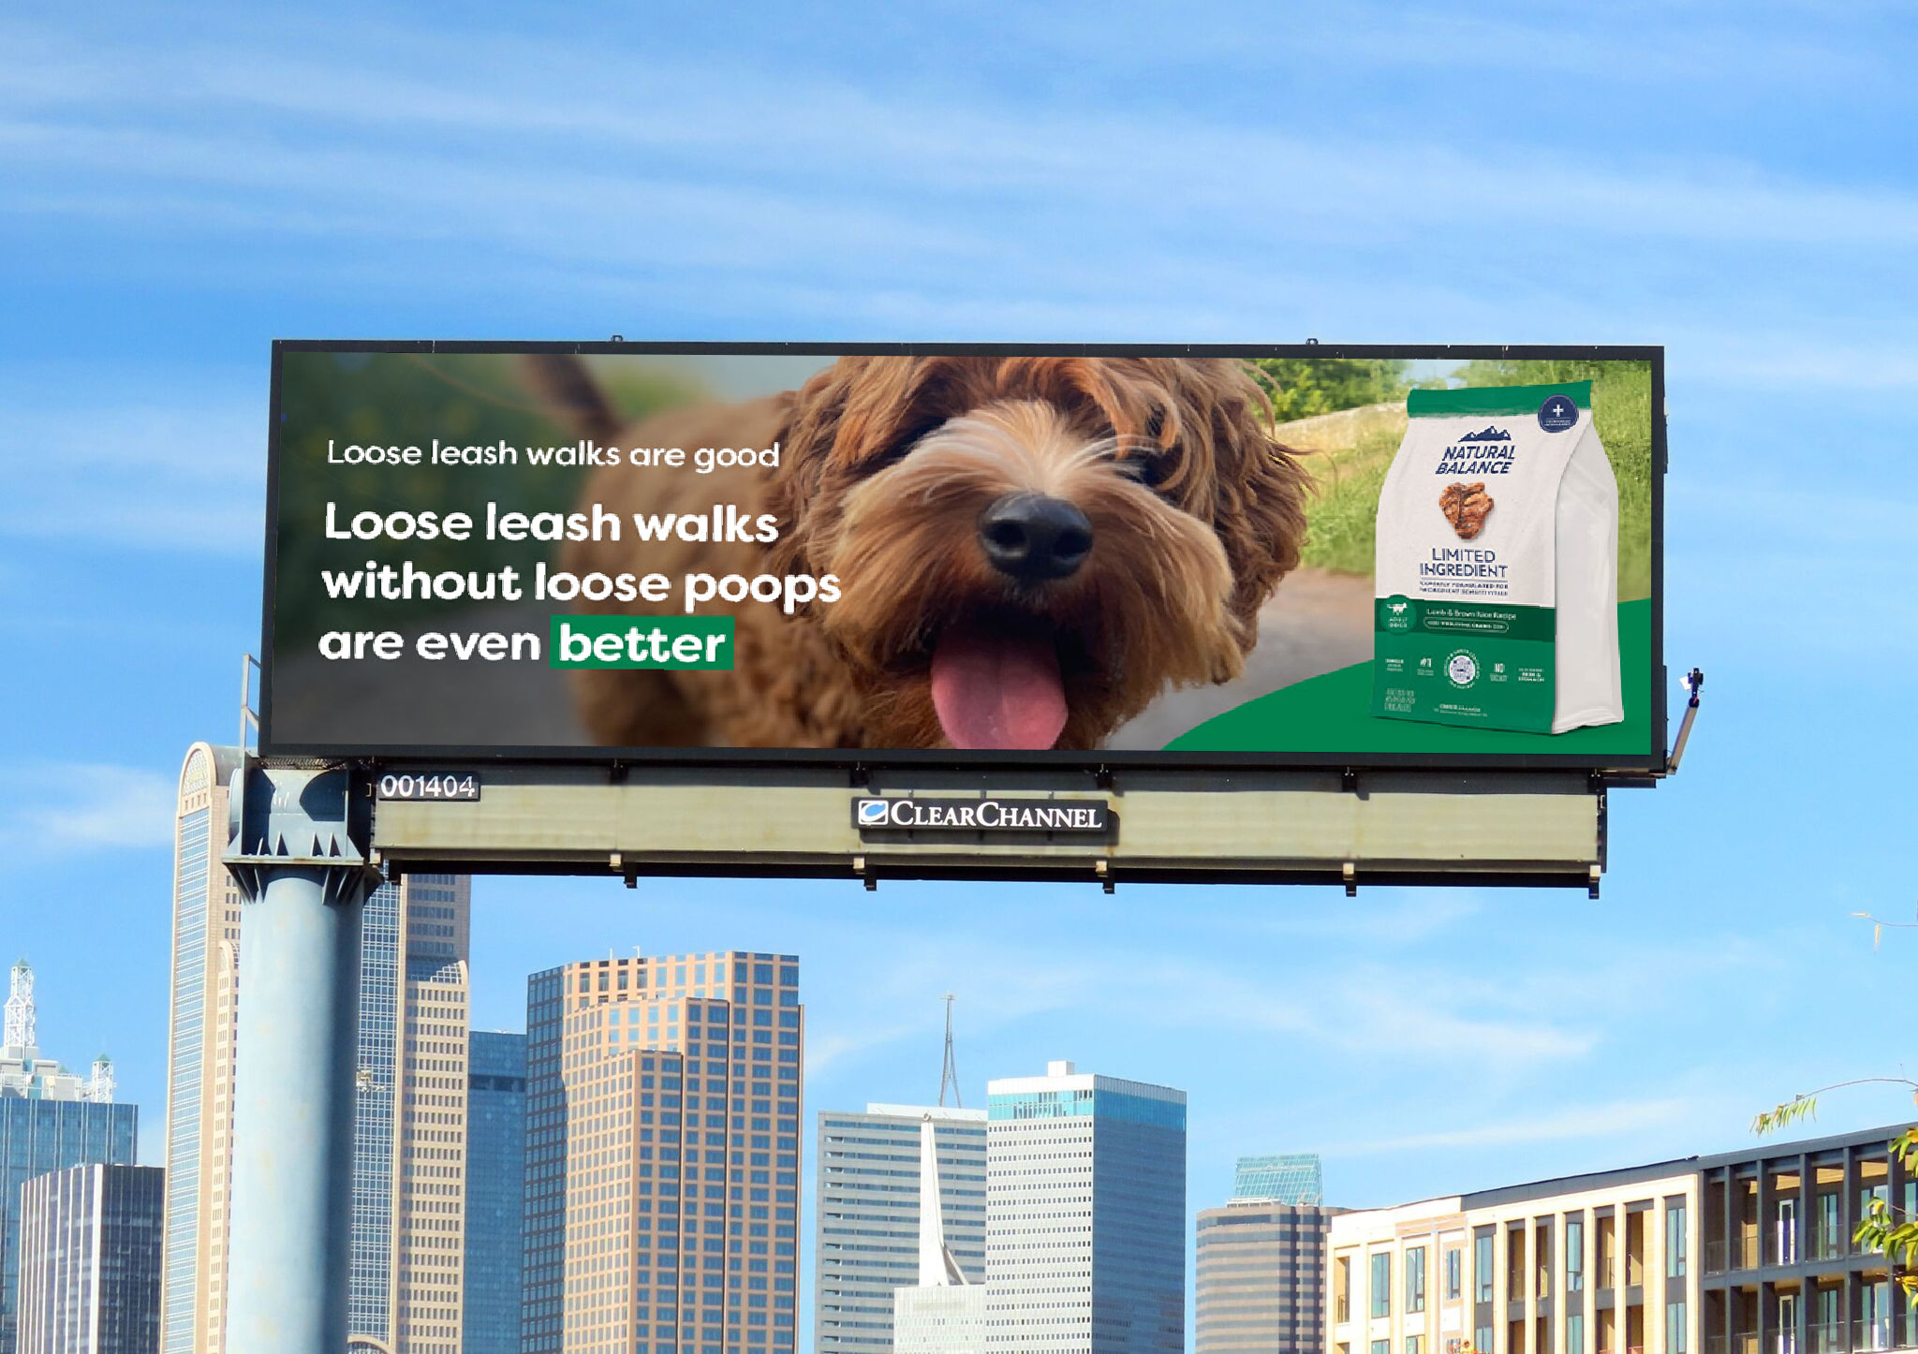
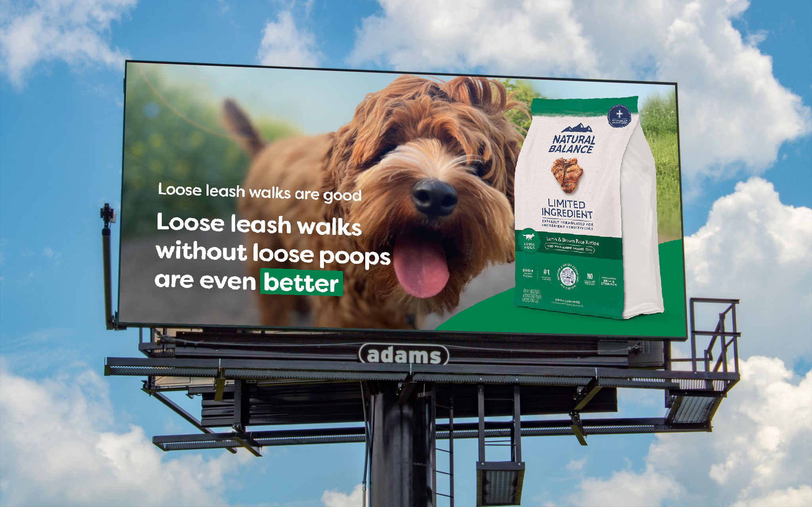
Campaign Mocks

Slide 9
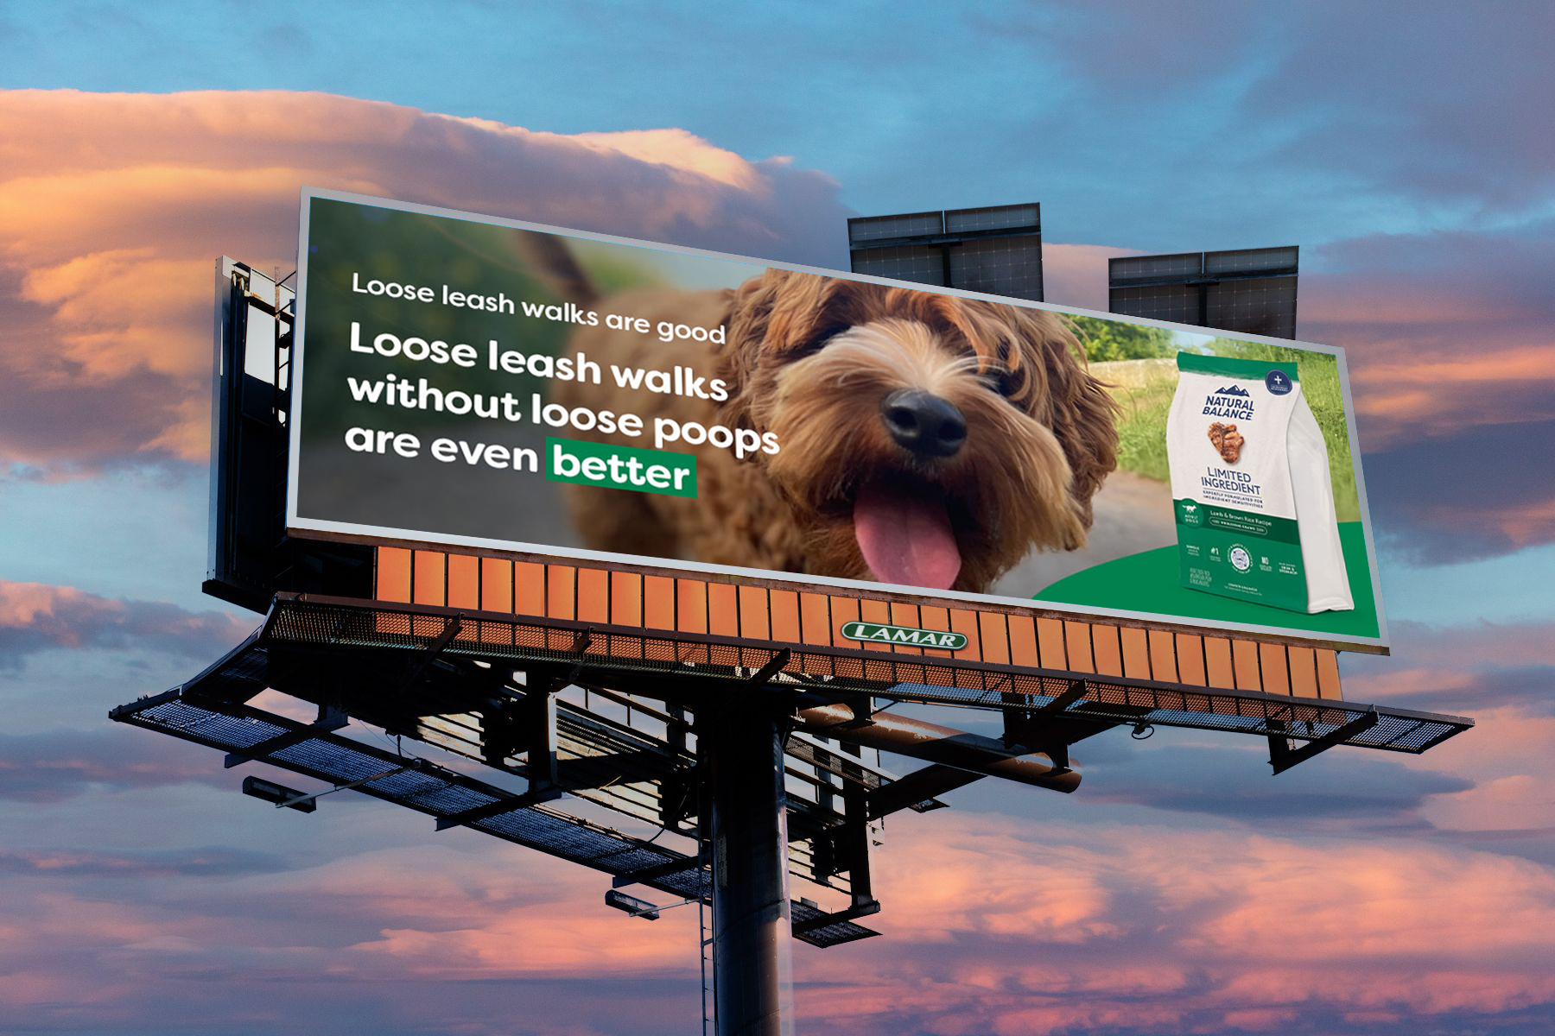
Campaign Mocks

Slide 10
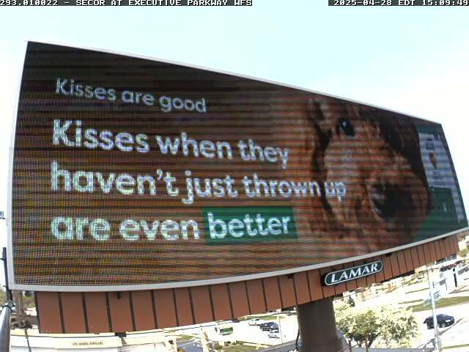
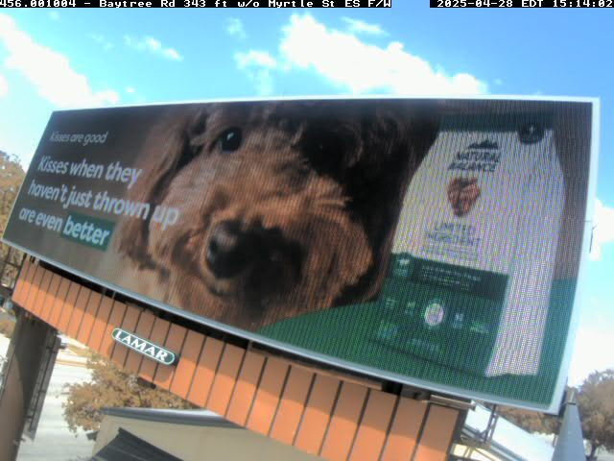
Campaign POP’S (Lamar)

Slide 11
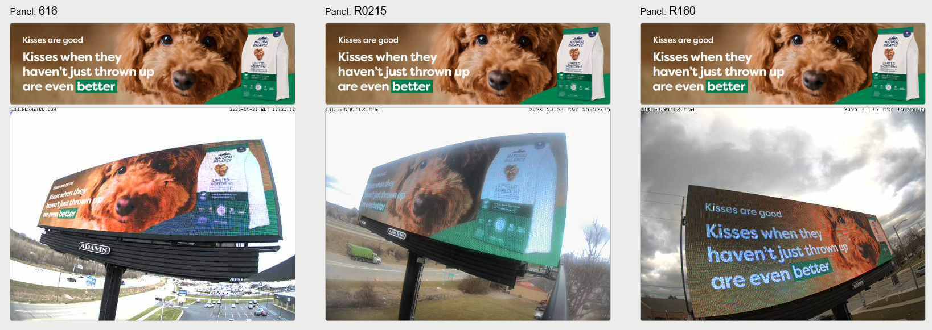
Campaign POP’S (Adams - Lansing,MI)

Slide 12
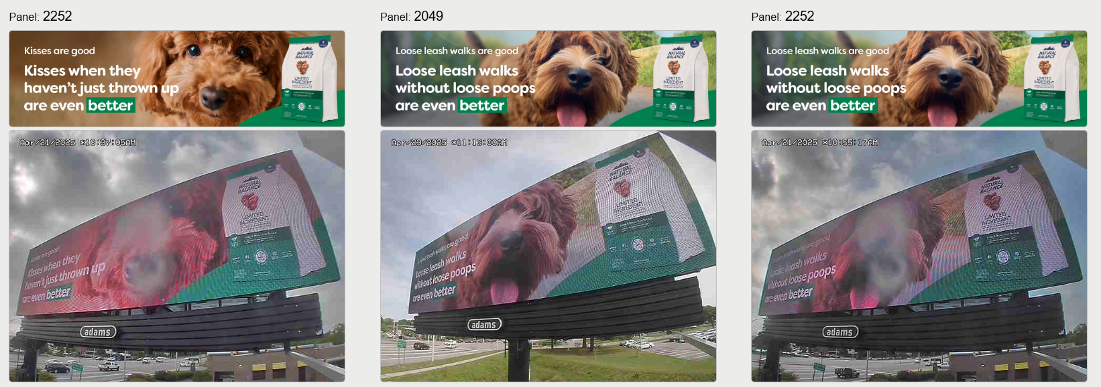
Campaign POP’S (Adams - Norfolk, VA)

Slide 13
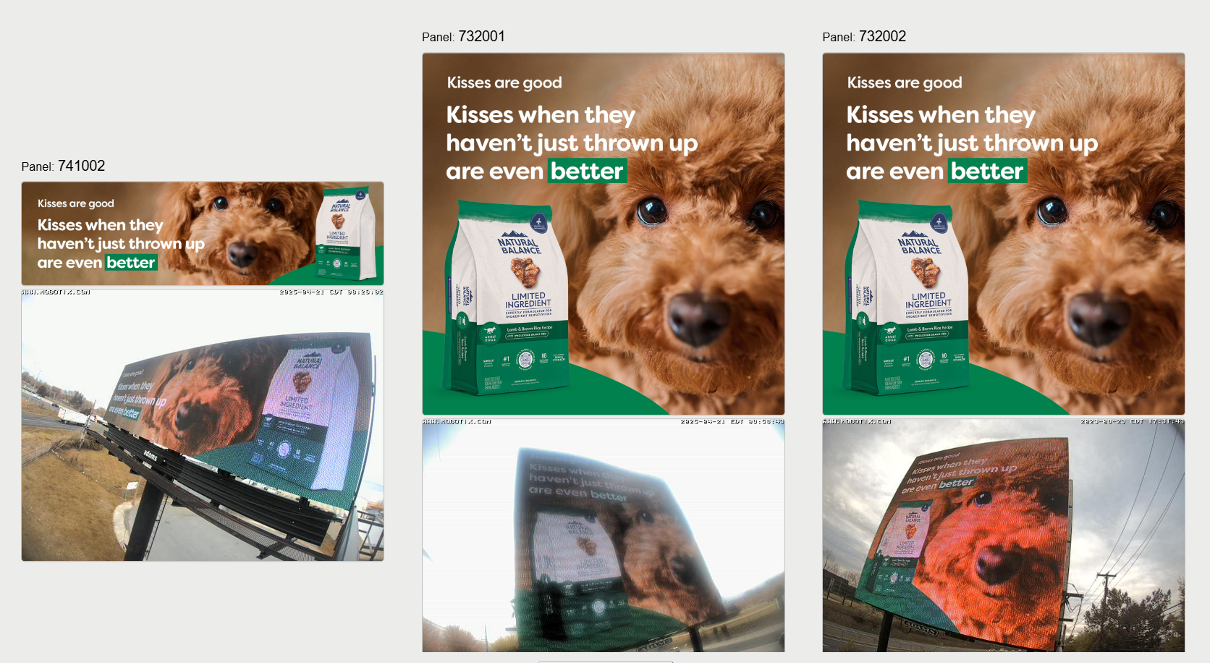
Campaign POP’S (Adams - Lehigh Valley, PA)

Slide 14
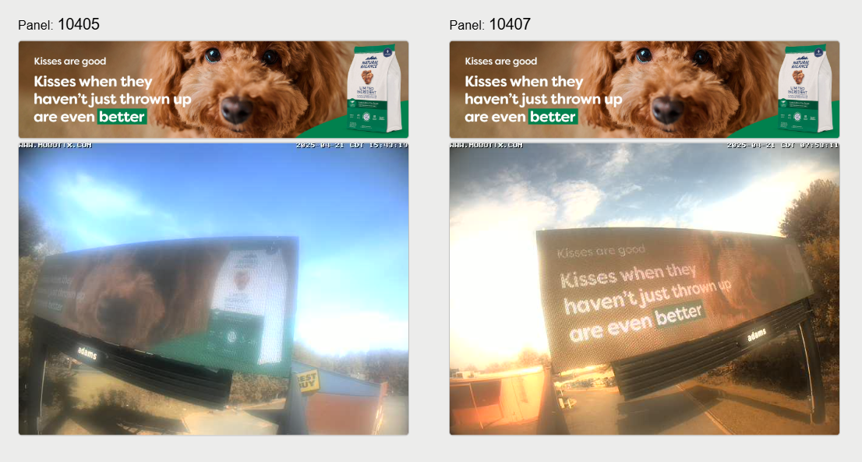
Campaign POP’S (Adams - Charlotte, NC)

Slide 15
CONTACT US
Tiara Bravo
Senior Account Executive
tiara.bravo@broadsign.com
Rajesh Jayaraman
Programmatic Account Manager
rajesh.jayaraman@broadsign.com

